Slide 1
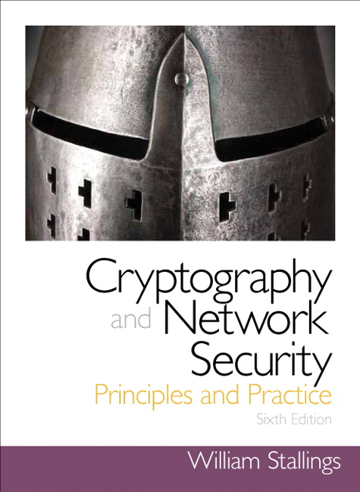
Chapter 3
Notes:
Classical Encryption Techniques

Slide 2
Basic Terminology
Plaintext (P)
The original message
Ciphertext (C)
The coded message
Enciphering or encryption (E)
Process of converting from plaintext to ciphertext
Deciphering or decryption (D)
Restoring the plaintext from the ciphertext
Cryptography
Science of Studying encryption and decryption.
Cryptographic system or cipher
Algorithm/scheme used for encryption
Cryptanalysis
Techniques used for deciphering a message without any knowledge of the enciphering details
Cryptology
Areas of cryptography and cryptanalysis together
Notes:
Before beginning, we define some terms. An original message is known as the
plaintext , while the coded message is called the ciphertext . The process of converting
from plaintext to ciphertext is known as enciphering or encryption ; restoring the
plaintext from the ciphertext is deciphering or decryption . The many schemes used
for encryption constitute the area of study known as cryptography . Such a scheme
is known as a cryptographic system or a cipher . Techniques used for deciphering
a message without any knowledge of the enciphering details fall into the area of
cryptanalysis . Cryptanalysis is what the layperson calls “breaking the code.” The areas
of cryptography and cryptanalysis together are called cryptology .

Slide 3
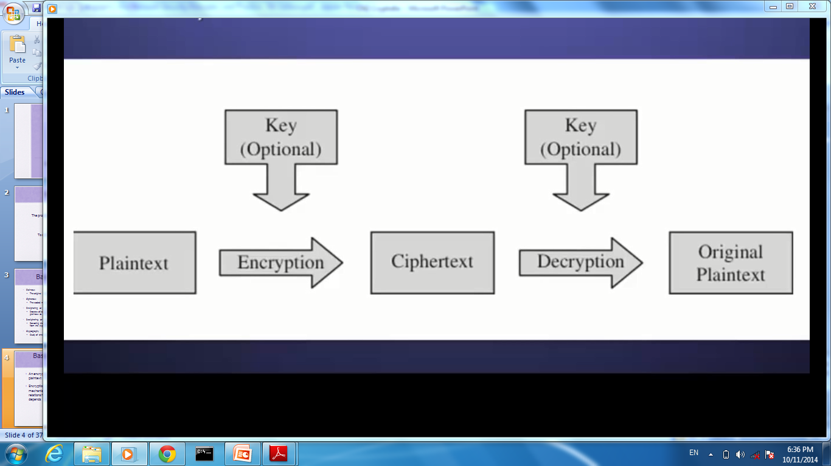
Basic Cryptographic Scheme
Encryption algorithm often relay on a mechanism known as a key, such that the relationship between plaintext and ciphertext depends upon the algorithm and the key.

Slide 4
Types of Ciphers
Digital Data Security
Cryptography
Information Hiding
Steganography
Watermarking
Secrete Communication
Confidential Data Storage
Copyright Protection
Multimedia Authentication
Notes:
Another type of unwanted access is the placement in a computer system
of logic that exploits vulnerabilities in the system and that can affect application
programs as well as utility programs, such as editors and compilers. Programs can
present two kinds of threats:
• Information access threats: Intercept or modify data on behalf of users who
should not have access to that data.
• Service threats: Exploit service flaws in computers to inhibit use by legitimate
users.
Viruses and worms are two examples of software attacks. Such attacks can be
introduced into a system by means of a disk that contains the unwanted logic concealed
in otherwise useful software. They can also be inserted into a system across a
network; this latter mechanism is of more concern in network security.
The security mechanisms needed to cope with unwanted access fall into
two broad categories (see Figure 1.3). The first category might be termed a gatekeeper
function. It includes password-based login procedures that are designed
to deny access to all but authorized users and screening logic that is designed
to detect and reject worms, viruses, and other similar attacks. Once either an
unwanted user or unwanted software gains access, the second line of defense
consists of a variety of internal controls that monitor activity and analyze stored
information in an attempt to detect the presence of unwanted intruders. These
issues are explored in Part Six.

Slide 5
Steganography
an alternative to encryption
hides existence of message :
using only a subset of letters/words in a longer message marked in some way.
using invisible ink.
Notes:
Steganography is an alternative to encryption which hides the very existence of a message by some means. There are a large range of techniques for doing this.
Steganography has a number of drawbacks when compared to encryption. It requires a lot of overhead to hide a relatively few bits of information.
Also, once the system is discovered, it becomes virtually worthless, although a message can be first encrypted and then hidden using steganography.
***Wildly unsubstantiated claims in Sept 2001 that Al-Qaeda had been using steganography in public bulletin board systems to communicate
-- pretty silly, since we didn’t even know who the terrorists were!

Slide 7
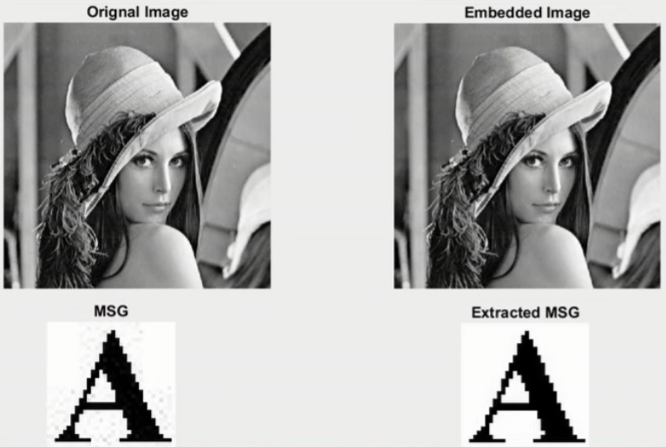

Slide 8
Types of Ciphers
Cryptography
Classical (Keyless)
Modern (Key-based)
Substitution
Transposition
Mono-
alphabetic
Poly-
alphabetic
Poly-
graphic
Rail Fence
Row transposition
Hill cipher
Caesar
Affine
Vigenere
Vernam
One-time pad
Playfair
Notes:
Substitution cipher can be divided into:
Monoalphabetic Ciphers: a type of cipher where each character of the plaintext is mapped to a corresponding character in the cipher text using a single alphabetic key.
The relationship between a character in the plain text and the characters in the cipher text is one-to-one.
Monoalphabetic cipher is a substitution cipher in which for a given key, the cipher alphabet for each plain alphabet is fixed throughout the encryption process. For example, if ‘A’ is encrypted as ‘D’, for any number of occurrence in that plaintext, ‘A’ will always get encrypted to ‘D’.
2. Polyalphabatic Ciphers : is any cipher based on substitution, using multiple substitution alphabets.
The relationship between a character in the plain text and the characters in the cipher text is one-to-many.

Slide 9
Types of Ciphers
Cryptography
Classical
Modern (Key-based)
Symmetric
Asymmetric
Hash Function
Block
Stream
RSA
Diffie-Hellman
MD5
SHA
DES
AES
RC4
Notes:
Hash function: one way function

Slide 10
Classification of Cryptosystems
Keyless
Less secure than keyed systems
Keyed
Symmetric keyed system
This is the classic keyed approach
The same key is used for both encryption and decryption.
Asymmetric keyed system
Also Know as a public key system
One key is used for encryption, while a very different one used for decryption
One key cannot be computationally derived from the other

Slide 11
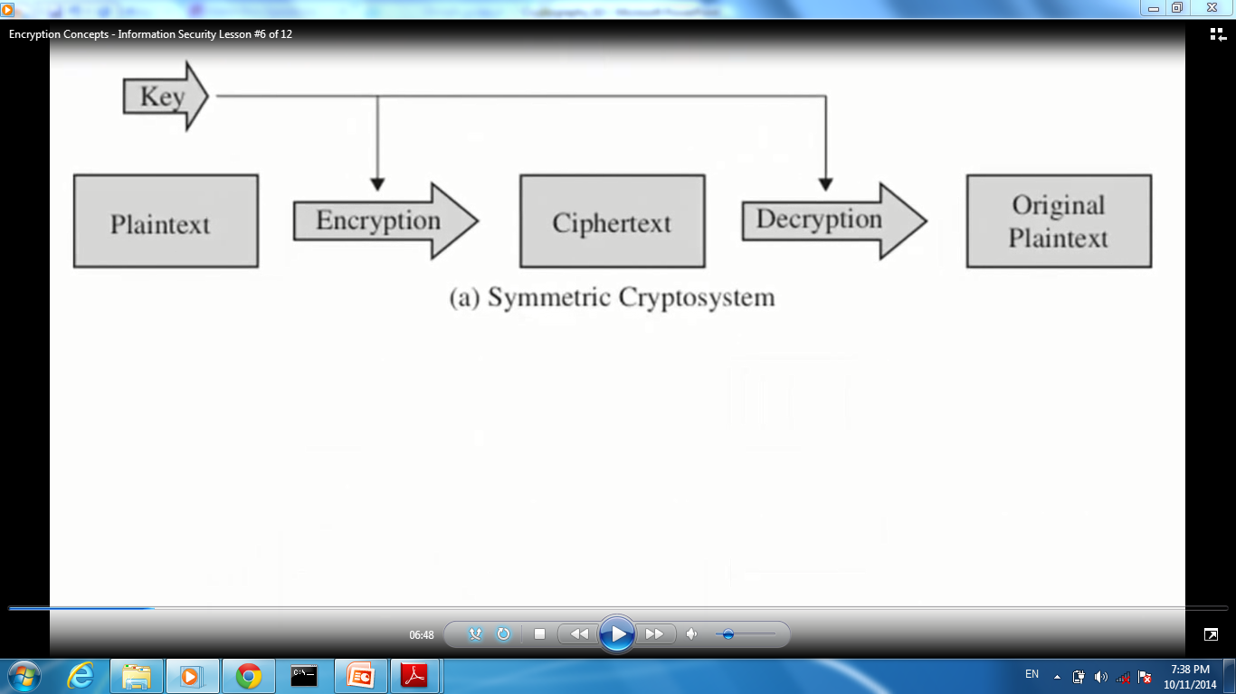
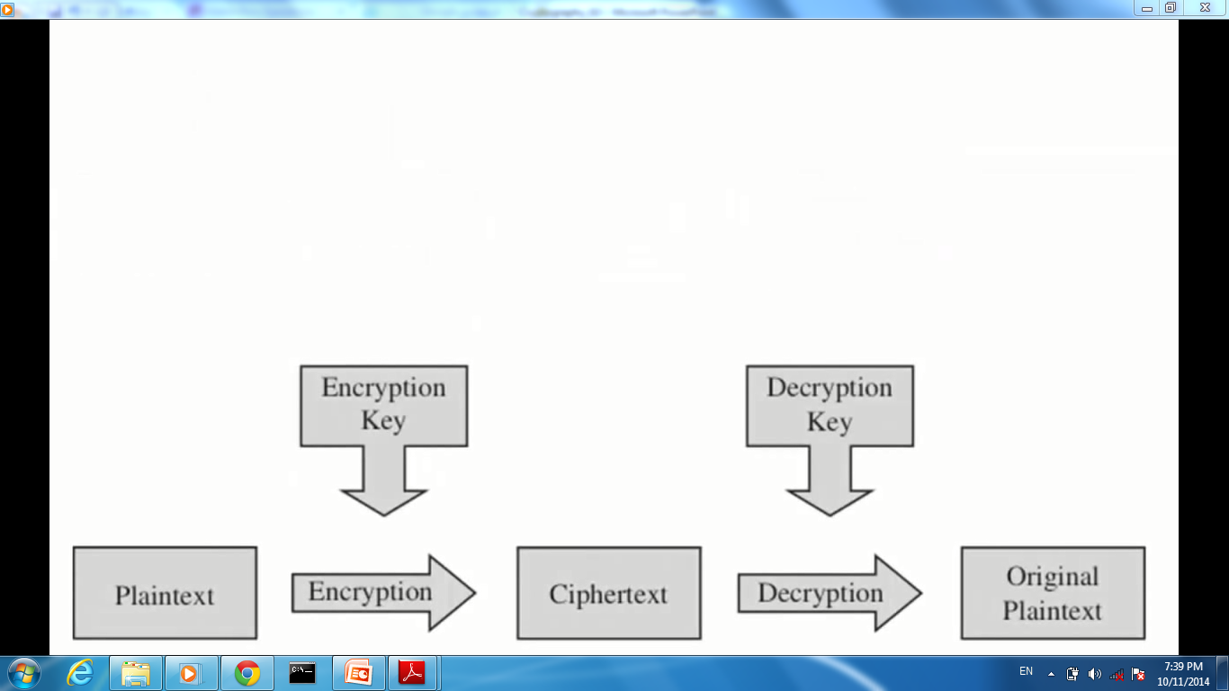
(b) Asymmetric Cryptosystem

Slide 12
Cryptographic Systems
Characterized along three independent dimensions:
The type of operations used for transforming plaintext to ciphertext
Substitution
Transposition
The number of keys used
Symmetric, single-key, secret-key, conventional encryption
Asymmetric, two-key, or public-key encryption
The way in which the plaintext is processed
Block cipher
Stream cipher
Notes:
Cryptographic systems are characterized along three independent dimensions:
1. The type of operations used for transforming plaintext to ciphertext. All
encryption algorithms are based on two general principles: substitution, in
which each element in the plaintext (bit, letter, group of bits or letters) is
mapped into another element, and transposition, in which elements in the
plaintext are rearranged. The fundamental requirement is that no information
be lost (i.e., that all operations are reversible). Most systems, referred to as
product systems , involve multiple stages of substitutions and transpositions.
2. The number of keys used. If both sender and receiver use the same key, the
system is referred to as symmetric, single-key, secret-key, or conventional
encryption. If the sender and receiver use different keys, the system is referred
to as asymmetric, two-key, or public-key encryption.
3. The way in which the plaintext is processed. A block cipher processes the
input one block of elements at a time, producing an output block for each
input block. A stream cipher processes the input elements continuously,
producing output one element at a time, as it goes along.

Slide 13
Cryptanalysis
Techniques used for deciphering a message without any knowledge of the enciphering details
goals of cryptanalysis :
Break a single message.
Deduce the key(or equivalent) so that future messages can be easily broken.
Find vulnerabilities in the encryption algorithm.

Slide 14
Cryptanalysis and Brute-Force Attack
Cryptanalysis
Attack relies on the nature of the algorithm plus some knowledge of the general characteristics of the plaintext
Attack exploits the characteristics of the algorithm to attempt to deduce a specific plaintext or to deduce the key being used
Brute-force attack
Attacker tries every possible key on a piece of ciphertext until an intelligible translation into plaintext is obtained.
Notes:
Typically, the objective of attacking an encryption system is to recover the key in
use rather than simply to recover the plaintext of a single ciphertext. There are two
general approaches to attacking a conventional encryption scheme:
• Cryptanalysis: Cryptanalytic attacks rely on the nature of the algorithm plus
perhaps some knowledge of the general characteristics of the plaintext or
even some sample plaintext–ciphertext pairs. This type of attack exploits the
characteristics of the algorithm to attempt to deduce a specific plaintext or to
deduce the key being used.
• Brute-force attack: The attacker tries every possible key on a piece of ciphertext
until an intelligible translation into plaintext is obtained. On average, half
of all possible keys must be tried to achieve success.
If either type of attack succeeds in deducing the key, the effect is catastrophic:
All future and past messages encrypted with that key are compromised.

Slide 15
Breakable Encryption
It is theoretically possible to devise unbreakable cryptosystems.
Practical cryptosystems are almost breakable by given enough time and computing power.
The objective is to make breaking so difficult.
This guide us to encryption scheme security or security of algorithms.

Slide 16
Encryption Scheme Security
You are probably safe:
If the cost required to breaking an algorithm is greater than the value of encrypted data
If the time required to break an algorithm is longer than the time encrypted must remain secret.
Notes:
Two more definitions are worthy of note. An encryption scheme is unconditionally
secure if the ciphertext generated by the scheme does not contain enough
information to determine uniquely the corresponding plaintext, no matter how
much ciphertext is available. That is, no matter how much time an opponent has, it
is impossible for him or her to decrypt the ciphertext simply because the required
information is not there. With the exception of a scheme known as the one-time pad
(described later in this chapter), there is no encryption algorithm that is unconditionally
secure. Therefore, all that the users of an encryption algorithm can strive
for is an algorithm that meets one or both of the following criteria:
• The cost of breaking the cipher exceeds the value of the encrypted information.
• The time required to break the cipher exceeds the useful lifetime of the
information.
An encryption scheme is said to be computationally secure if either of the
foregoing two criteria are met. Unfortunately, it is very difficult to estimate the
amount of effort required to cryptanalyze ciphertext successfully.
All forms of cryptanalysis for symmetric encryption schemes are designed
to exploit the fact that traces of structure or pattern in the plaintext may survive
encryption and be discernible in the ciphertext. This will become clear as we examine
various symmetric encryption schemes in this chapter. We will see in Part Two
that cryptanalysis for public-key schemes proceeds from a fundamentally different
premise, namely, that the mathematical properties of the pair of keys may make it
possible for one of the two keys to be deduced from the other.

Slide 17
Representing Letters numerically
Letters (English language) are represented by the numbers 0 through 25
A B C …. X Y Z
0 1 2 …. 23 24 25.
Mathematical operations on letters:
A+2 = C
X+4 = 27 !! No letter has this number
so we use (mod 26) for wrapper around.
(X+4) mod 26 = B OR 1
Y-1 = X

Slide 18
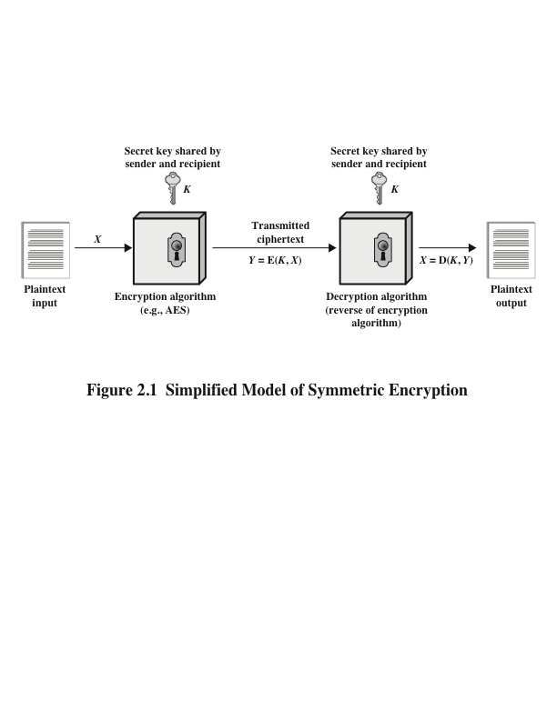
Simplified Model of Symmetric Encryption
Notes:
A symmetric encryption scheme has five ingredients (Figure 2.1):
• Plaintext: This is the original intelligible message or data that is fed into the
algorithm as input.
• Encryption algorithm: The encryption algorithm performs various substitutions
and transformations on the plaintext.
• Secret key: The secret key is also input to the encryption algorithm. The key
is a value independent of the plaintext and of the algorithm. The algorithm
will produce a different output depending on the specific key being used at the
time. The exact substitutions and transformations performed by the algorithm
depend on the key.
• Ciphertext: This is the scrambled message produced as output. It depends on
the plaintext and the secret key. For a given message, two different keys will
produce two different ciphertexts. The ciphertext is an apparently random
stream of data and, as it stands, is unintelligible.
• Decryption algorithm: This is essentially the encryption algorithm run in
reverse. It takes the ciphertext and the secret key and produces the original
plaintext.

Slide 19
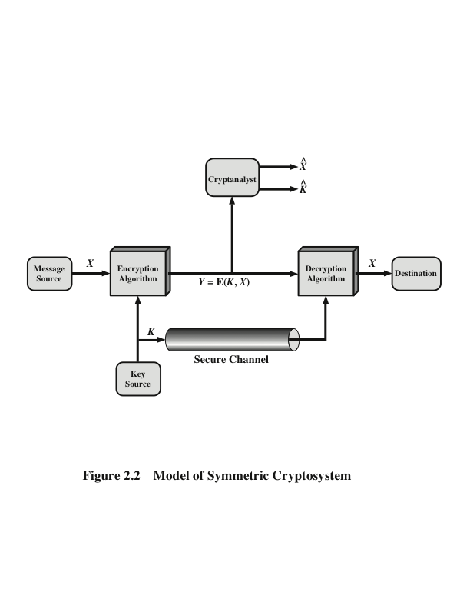
Model of Symmetric Cryptosystem
Notes:
Let us take a closer look at the essential elements of a symmetric
encryption scheme, using Figure 2.2.
Let us take a closer look at the essential elements of a symmetric encryption
scheme, using Figure 2.2. A source produces a message in plaintext,
. The elements of are letters in some finite alphabet.
Traditionally, the alphabet usually consisted of the 26 capital letters. Nowadays,
the binary alphabet {0, 1} is typically used. For encryption, a key of the form
is generated. If the key is generated at the message source,
then it must also be provided to the destination by means of some secure channel.
Alternatively, a third party could generate the key and securely deliver it to
both source and destination.
With the message and the encryption key as input, the encryption algorithm
forms the ciphertext .We can write this as
This notation indicates that is produced by using encryption algorithm E as a
function of the plaintext , with the specific function determined by the value of
the key .
The intended receiver, in possession of the key, is able to invert the
transformation:
An opponent, observing but not having access to or , may attempt to
recover or or both and . It is assumed that the opponent knows the encryption
(E) and decryption (D) algorithms. If the opponent is interested in only this particular
message, then the focus of the effort is to recover by generating a plaintext estimate
. Often, however, the opponent is interested in being able to read future messages as
well, in which case an attempt is made to recover by generating an estimate .

Slide 20
Substitution Technique
Is one in which the letters of plaintext are replaced by other letters or by numbers or symbols
If the plaintext is viewed as a sequence of bits, then substitution involves replacing plaintext bit patterns with ciphertext bit patterns
Notes:
In this section and the next, we examine a sampling of what might be called classical
encryption techniques. A study of these techniques enables us to illustrate the
basic approaches to symmetric encryption used today and the types of cryptanalytic
attacks that must be anticipated.
The two basic building blocks of all encryption techniques are substitution
and transposition. We examine these in the next two sections. Finally, we discuss a
system that combines both substitution and transposition.
A substitution technique is one in which the letters of plaintext are replaced by
other letters or by numbers or symbols. If the plaintext is viewed as a sequence of bits,
then substitution involves replacing plaintext bit patterns with ciphertext bit patterns.
Mono : a always p in cipher
Polyalpha : a is sometime p or other letter based on the key cross.

Slide 21
Substitution Technique
Substitution cipher can be divided into:
Monoalphabetic Ciphers: a type of cipher where each character of the plaintext is mapped to a corresponding character in the cipher text using a single alphabetic key.
The relationship between a character in the plain text and the characters in the cipher text is one-to-one.
Example: Caesar cipher, where each letter is shifted based on a numeric key.

Slide 22
Substitution Technique
Substitution cipher can be divided into
2. Polyalphabatic Ciphers : is any cipher based on substitution, using multiple substitution alphabets.
The relationship between a character in the plain text and the characters in the cipher text is one-to-many.
Example: Vigenère cipher

Slide 23
Substitution Technique
Substitution cipher can be divided into
2. Polygraphic Ciphers : are substitution ciphers that substitute for a string of more than one letter at once.
These are also called block ciphers.
The main point is that the substitution depends simultaneously on all of the letters in the string; if one letter changes, many changes should occur in the ciphertext.

Slide 24
Caesar Cipher
Simplest and earliest known use of a substitution cipher
Used by Julius Caesar
Involves replacing each letter of the alphabet with the letter standing three places further down the alphabet
Alphabet is wrapped around so that the letter following Z is A
plain: meet me after the toga party
cipher: PHHW PH DIWHU WKH WRJD SDUWB
Notes:
The earliest known, and the simplest, use of a substitution cipher was by Julius
Caesar. The Caesar cipher involves replacing each letter of the alphabet with the
letter standing three places further down the alphabet.
Note that the alphabet is wrapped around, so that the letter following Z is A.

Slide 25
Caesar Cipher Algorithm
Can define transformation as:
a b c d e f g h i j k l m n o p q r s t u v w x y z
D E F G H I J K L M N O P Q R S T U V W X Y Z A B C
Mathematically give each letter a number
a b c d e f g h i j k l m n o p q r s t u v w x y z
0 1 2 3 4 5 6 7 8 9 10 11 12 13 14 15 16 17 18 19 20 21 22 23 24 25
Algorithm can be expressed as:
c = E(3, p) = (p + 3) mod (26)
A shift may be of any amount, so that the general Caesar algorithm is:
C = E(k , p ) = (p + k ) mod 26
Where k takes on a value in the range 1 to 25; the decryption algorithm is simply:
p = D(k , C ) = (C - k ) mod 26
Notes:
Then the algorithm can be expressed as follows. For each plaintext letter p , substitute
the ciphertext letter C

Slide 26
Cryptanalysis Caesar Cipher
If it is known that a given ciphertext is a Caesar cipher, then a brute-force cryptanalysis is easily performed by simply trying all 25 possible keys.
Three important characteristics of this problem enables us to use brute-force cryptanalysis:
Algorithm is known (Caesar cipher)
There are only 25 key to try.
The language of plaintext is known.

Slide 27
Cryptanalysis Caesar Cipher
Example : Suppose we are walking down the street and find a lost note that says:
Suppose that we suspect this message in English enciphered by shift cipher. How do we go about deciphering it ?
To : SMITH
From : WESSON
JR EBO GUR ONAX NG ZVQAVTUG

Slide 28
Cryptanalysis Caesar Cipher
To : SMITH
From : WESSON
JR EBO GUR ONAX NG ZVQAVTUG
Start with K = 1.
It is not English meaningful words. Then we would try K = 2 to get another meaningless words.
To make it easier we could use facts about letter frequency in English to find the value of shifting.
To : SMITH
From : WESSON
IQ DAN FTZ ……..

Slide 29
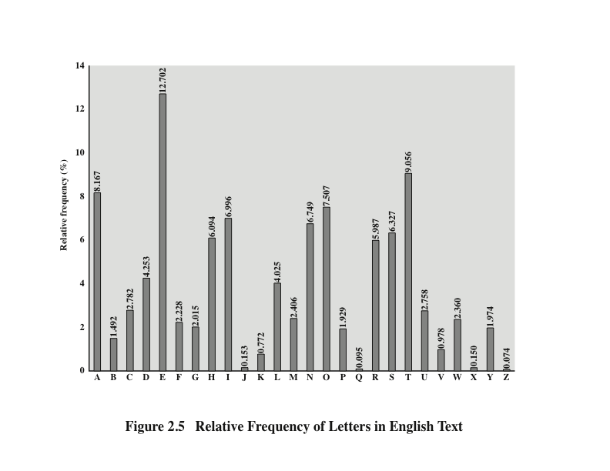
Notes:
There is, however, another line of attack. If the cryptanalyst knows the nature
of the plaintext (e.g., noncompressed English text), then the analyst can exploit the
regularities of the language. To see how such a cryptanalysis might proceed, we give
a partial example here that is adapted from one in [SINK09]. The ciphertext to be
solved is
UZQSOVUOHXMOPVGPOZPEVSGZWSZOPFPESXUDBMETSXAIZ
VUEPHZHMDZSHZOWSFPAPPDTSVPQUZWYMXUZUHSX
EPYEPOPDZSZUFPOMBZWPFUPZHMDJUDTMOHMQ
As a first step, the relative frequency of the letters can be determined and
compared to a standard frequency distribution for English, such as is shown in
Figure 2.5 (based on [LEWA00]). If the message were long enough, this technique
alone might be sufficient, but because this is a relatively short message, we cannot
expect an exact match. In any case, the relative frequencies of the letters in the
ciphertext (in percentages) are as follows:
P 13.33 H 5.83 F 3.33 B 1.67 C 0.00
Z 11.67 D 5.00 W 3.33 G 1.67 K 0.00
S 8.33 E 5.00 Q 2.50 Y 1.67 L 0.00
U 8.33 V 4.17 T 2.50 I 0.83 N 0.00
O 7.50 X 4.17 A 1.67 J 0.83 R 0.00
M 6.67
ccccbComparing this breakdown with Figure 2.5, it seems likely that cipher letters P
and Z are the equivalents of plain letters e and t, but it is not certain which is which.
The letters S, U, O, M, and H are all of relatively high frequency and probably correspond
to plain letters from the set {a, h, i, n, o, r, s}. The letters with the lowest
frequencies (namely, A, B, G, Y, I, J) are likely included in the set {b, j, k, q, v, x, z}.
There are a number of ways to proceed at this point. We could make some tentative
assignments and start to fill in the plaintext to see if it looks like a reasonable
“skeleton” of a message. A more systematic approach is to look for other regularities.
For example, certain words may be known to be in the text. Or we could look for
repeating sequences of cipher letters and try to deduce their plaintext equivalents.

Slide 30
Cryptanalysis Caesar Cipher
The most frequently letters in ordinary English are E, T, N, O, R, I, and A.
In our example, the letter G occurs three times in the message, and each of N, O, R, U, V and A occurs twice. The reminder letters occurs once.
So it is reasonable to suppose G corresponds E (shift by 2). The result will be :
GP CZM ……. XTOY….
Unintelligible(not clear) !!
So we try to consider that G is the next cleartext frequently letter T.

Slide 31
Cryptanalysis Caesar Cipher
So K = 13
To : SMITH
From : WESSON
JR EBO GUR ONAX NG ZVQAVTUG
To : SMITH
From : WESSON
WE ROB THE BANK AT MIDNIGHT

Slide 32
Affine Cipher
The affine cipher is a type of monoalphabetic substitution cipher.
Mathematically, the encryption function for a single letter is E(x)=(ax+b)mod26
The decryption function is D(x)=a⁻¹(x-b)mod26
(a,b) are the key of the cipher
Notes:
The best-known multiple-letter encryption cipher is the Playfair, which treats
digrams in the plaintext as single units and translates these units into ciphertext
Digrams.
The Playfair algorithm is based on the use of a 5 * 5 matrix of letters constructed
using a keyword.

Slide 33
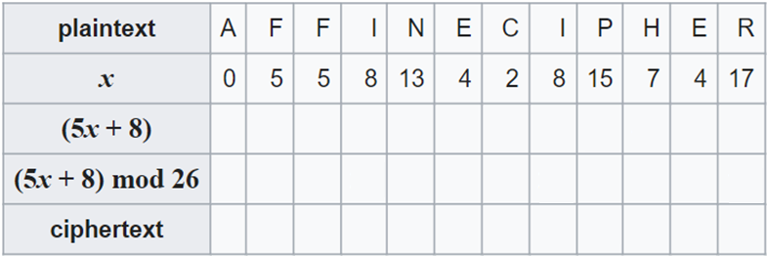
Affine Cipher
Example: Encrypt the plaintext "AFFINE CIPHER" using the encryption key (a,b) 0f (5,8):
a b c d e f g h i j k l m n o p q r s t u v w x y z
0 1 2 3 4 5 6 7 8 9 10 11 12 13 14 15 16 17 18 19 20 21 22 23 24 25
Notes:
The best-known multiple-letter encryption cipher is the Playfair, which treats
digrams in the plaintext as single units and translates these units into ciphertext
Digrams.
The Playfair algorithm is based on the use of a 5 * 5 matrix of letters constructed
using a keyword.

Slide 34
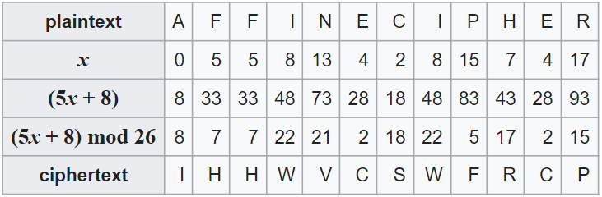
Affine Cipher
Example: Encrypt the plaintext "AFFINE CIPHER" using the encryption key (a,b) 0f (5,8):
a b c d e f g h i j k l m n o p q r s t u v w x y z
0 1 2 3 4 5 6 7 8 9 10 11 12 13 14 15 16 17 18 19 20 21 22 23 24 25
Notes:
The best-known multiple-letter encryption cipher is the Playfair, which treats
digrams in the plaintext as single units and translates these units into ciphertext
Digrams.
The Playfair algorithm is based on the use of a 5 * 5 matrix of letters constructed
using a keyword.

Slide 35
Affine Cipher
Example: Decrypt the ciphertext “IHHWVCSWFRCP" using the encryption key (a,b) 0f (5,8):
D(x)=a⁻¹(x-b)mod26
To find the modular inverse of 5 modulo 26 (5⁻¹), we need to determine the value x such that:
5×x⁻¹ ≡1 (mod 26)=21
Notes:
To find the modular inverse of 5 modulo 26, we need to determine the value x such that:
5×x≡1 (mod 26)

Slide 36
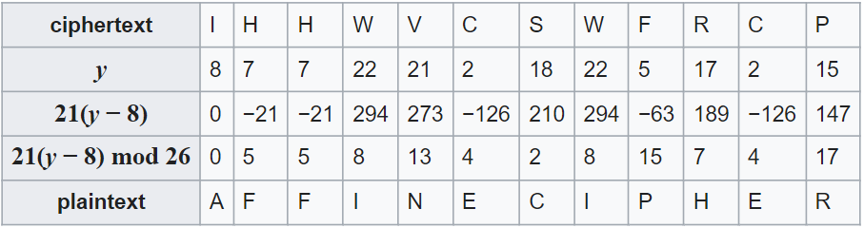
Affine Cipher
Example: Decrypt the ciphertext “IHHWVCSWFRCP" using the encryption key (a,b) 0f (5,8):
D(x)=a⁻¹(x-b)mod26
a b c d e f g h i j k l m n o p q r s t u v w x y z
0 1 2 3 4 5 6 7 8 9 10 11 12 13 14 15 16 17 18 19 20 21 22 23 24 25
Notes:
To find −21 mod 26, -21+26=5
To find −126 mod 26, we need to find the equivalent positive value of −126 within the modulo 26 system.
Here's the step-by-step calculation:
Start with the negative number: −126
Add the modulus (26) repeatedly until you get a positive result within the range of 0 to 25:
−126+26=−100
−100+26=−74
−74 −74+26=−48
−48+26=−22
−22+26=4
Therefore, −126 mod 26=4
This shows that −126 is congruent to 4 modulo 26

Slide 37
Polyalphabetic Ciphers
Polyalphabetic substitution cipher
Improves on the simple monoalphabetic technique by using different monoalphabetic substitutions as one proceeds through the plaintext message
All these techniques have the following features in common:
A set of related monoalphabetic substitution rules is used
A key determines which particular rule is chosen for a given transformation
Notes:
Another way to improve on the simple monoalphabetic technique is to use different
monoalphabetic substitutions as one proceeds through the plaintext message.
The general name for this approach is polyalphabetic substitution cipher . All these
techniques have the following features in common:
1. A set of related monoalphabetic substitution rules is used.
2. A key determines which particular rule is chosen for a given transformation.

Slide 38
Playfair Cipher
Invented by British scientist Sir Charles Wheatstone in 1854
Used as the standard field system by the British Army in World War I and the U.S. Army and other Allied forces during World War II
Best-known multiple-letter encryption cipher
Treats digrams in the plaintext as single units and translates these units into ciphertext digrams
Based on the use of a 5 x 5 matrix of letters constructed using a keyword
Notes:
The best-known multiple-letter encryption cipher is the Playfair, which treats
digrams in the plaintext as single units and translates these units into ciphertext
Digrams.
The Playfair algorithm is based on the use of a 5 * 5 matrix of letters constructed
using a keyword.

Slide 39
Playfair Key Matrix
Fill in letters of keyword (minus duplicates) from left to right and from top to bottom, then fill in the remainder of the matrix with the remaining letters in alphabetic order
Using the keyword MONARCHY:
M | O | N | A | R
C | H | Y | B | D
E | F | G | I/J | K
L | P | Q | S | T
U | V | W | X | Z
Notes:
In this case, the keyword is monarchy . The matrix is constructed by filling
in the letters of the keyword (minus duplicates) from left to right and from top to
bottom, and then filling in the remainder of the matrix with the remaining letters in
alphabetic order. The letters I and J count as one letter. Plaintext is encrypted two
letters at a time, according to the following rules:
1. Repeating plaintext letters that are in the same pair are separated with a filler
letter, such as x, so that balloon would be treated as ba lx lo on.
2. Two plaintext letters that fall in the same row of the matrix are each replaced
by the letter to the right, with the first element of the row circularly following
the last. For example, ar is encrypted as RM.
3. Two plaintext letters that fall in the same column are each replaced by the
letter beneath, with the top element of the column circularly following the last.
For example, mu is encrypted as CM.
4. Otherwise, each plaintext letter in a pair is replaced by the letter that lies in
its own row and the column occupied by the other plaintext letter. Thus, hs
becomes BP and ea becomes IM (or JM, as the encipherer wishes).
The Playfair cipher is a great advance over simple monoalphabetic ciphers.
For one thing, whereas there are only 26 letters, there are 26 * 26 = 676 digrams, so
that identification of individual digrams is more difficult. Furthermore, the relative
frequencies of individual letters exhibit a much greater range than that of digrams,
making frequency analysis much more difficult. For these reasons, the Playfair
cipher was for a long time considered unbreakable. It was used as the standard field
system by the British Army in World War I and still enjoyed considerable use by the
U.S. Army and other Allied forces during World War II.
Despite this level of confidence in its security, the Playfair cipher is relatively
easy to break, because it still leaves much of the structure of the plaintext language
intact. A few hundred letters of ciphertext are generally sufficient.

Slide 40
Playfair Cipher
Plaintext is encrypted two letters at a time, according to the following rules :
Divide plaintext each two letters together.
Repeating plaintext letters that are in the same pair are separated with a filler letter such as x.

Slide 41
Playfair Cipher
Example :
Plaintext: attack
Diagram: at ta ck
Plaintext: academy
Diagram: ac ad em yx
Plaintext: balloon
Diagram: ba lx lo on

Slide 42
Playfair Cipher
If the letters appear on the same row of your table, replace them with the letters to their immediate right respectively (wrapping around).
If the letters appear on the same column of your table, replace them with the letters immediately below respectively (wrapping around).
If the letters are not on the same row or column, make a rectangle and replace them with the letters on the same row but at the other pair of corners of the rectangle defined by the original pair.

Slide 43
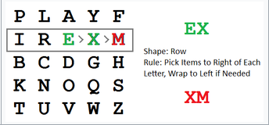
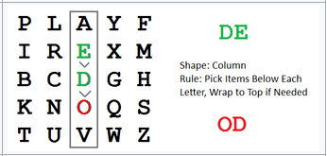
Playfair Cipher

Slide 44
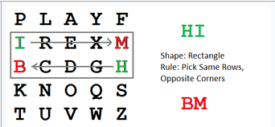
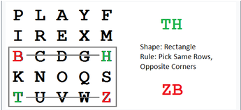
Playfair Cipher

Slide 45
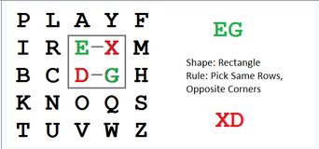
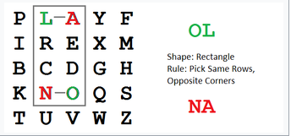
Playfair Cipher

Slide 46
Playfair Cipher
Given the following plaintext and key, find the ciphertext using the Playfair cipher.
P = Stall
K = security
C = ________

Slide 47
Vigenère Cipher
Best known and one of the simplest polyalphabetic substitution ciphers
In this scheme the set of related monoalphabetic substitution rules consists of the 26 Caesar ciphers with shifts of 0 through 25
Each cipher is denoted by a key letter which is the ciphertext letter that substitutes for the plaintext letter a
Notes:
The best known, and one of the simplest, polyalphabetic ciphers
is the Vigenère cipher. In this scheme, the set of related monoalphabetic substitution
rules consists of the 26 Caesar ciphers with shifts of 0 through 25. Each cipher is
denoted by a key letter, which is the ciphertext letter that substitutes for the plaintext
letter a. Thus, a Caesar cipher with a shift of 3 is denoted by the key value 3.

Slide 48
Vigenère Cipher with Repeating key
To encrypt a message, a key is needed that is as long as the message
Usually, the key is a repeating keyword
For example, if the keyword is deceptive, the message “we are discovered save yourself” is encrypted as:
key: deceptivedeceptivedeceptive
plaintext: wearediscoveredsaveyourself
ciphertext: ZICVTWQNGRZGVTWAVZHCQYGLMGJ
Notes:
To encrypt a message, a key is needed that is as long as the message. Usually,
the key is a repeating keyword. For example, if the keyword is deceptive , the
message “we are discovered save yourself” is encrypted as
key: deceptivedeceptivedeceptive
plaintext: wearediscoveredsaveyourself
ciphertext: ZICVTWQNGRZGVTWAVZHCQYGLMGJ
The strength of this cipher is that there are multiple ciphertext letters for
each plaintext letter, one for each unique letter of the keyword. Thus, the letter
frequency information is obscured. However, not all knowledge of the plaintext
structure is lost. For example, Figure 2.6 shows the frequency distribution for a
Vigenère cipher with a keyword of length 9. An improvement is achieved over the
Playfair cipher, but considerable frequency information remains.

Slide 49
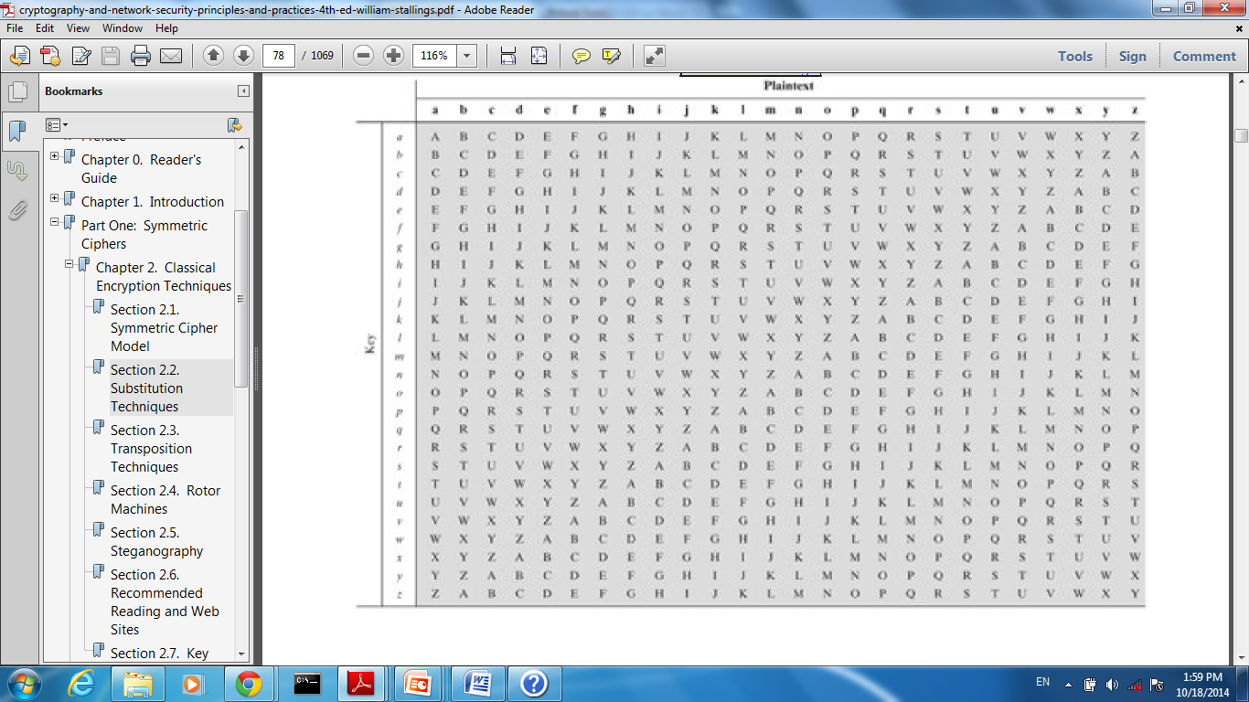

Slide 50
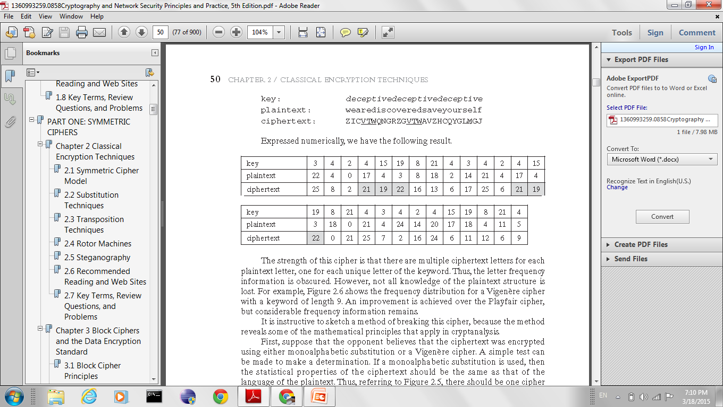
Example of Vigenère Cipher

Slide 51
Vigenère with Auto-key
A keyword is concatenated with the plaintext itself to provide a autokey
Example:
key: deceptivewearediscoveredsav
plaintext: wearediscoveredsaveyourself
ciphertext: ZICVTWQNGKZEIIGASXSTSLVVWLA
Even this scheme is vulnerable to cryptanalysis, because the key and the plaintext share the same frequency distribution of letters, a statistical technique can be applied
Notes:
The periodic nature of the keyword can be eliminated by using a nonrepeating
keyword that is as long as the message itself. Vigenère proposed what is referred to
as an autokey system , in which a keyword is concatenated with the plaintext itself to
provide a running key. For our example,
key: deceptivewearediscoveredsav
plaintext: wearediscoveredsaveyourself
ciphertext: ZICVTWQNGKZEIIGASXSTSLVVWLA
Even this scheme is vulnerable to cryptanalysis. Because the key and the
plaintext share the same frequency distribution of letters, a statistical technique
can be applied. For example, e enciphered by e , by Figure 2.5, can be expected to
occur with a frequency of (0.127⁾² = 0.016, whereas t enciphered by t would occur
only about half as often. These regularities can be exploited to achieve successful
cryptanalysis.

Slide 52
One-Time Pad
One-time pad cipher is a type of Vigenère cipher which includes the following features :
It is an unbreakable cipher.
The key is exactly same as the length of message which is encrypted.
The key is made up of random symbols.
As the name suggests, key is used one time only and never used again for any other message to be encrypted.
Notes:
An Army Signal Corp officer, Joseph Mauborgne, proposed an improvement to the
Vernam cipher that yields the ultimate in security. Mauborgne suggested using a
random key that is as long as the message, so that the key need not be repeated. In
addition, the key is to be used to encrypt and decrypt a single message, and then is
discarded. Each new message requires a new key of the same length as the new message.
Such a scheme, known as a one-time pad , is unbreakable. It produces random
output that bears no statistical relationship to the plaintext. Because the ciphertext
contains no information whatsoever about the plaintext, there is simply no way to
break the code.
In fact, given any plaintext of equal length to the ciphertext, there is a key that
produces that plaintext. Therefore, if you did an exhaustive search of all possible
keys, you would end up with many legible plaintexts, with no way of knowing which
was the intended plaintext. Therefore, the code is unbreakable.
The security of the one-time pad is entirely due to the randomness of
the key. If the stream of characters that constitute the key is truly random, then the
stream of characters that constitute the ciphertext will be truly random. Thus, there
are no patterns or regularities that a cryptanalyst can use to attack the ciphertext.

Slide 53
One-Time Pad
proposed by an Army Signal Corp officer, Joseph Mauborgne
Use a random key that is as long as the message so that the key need not be repeated
Key is used to encrypt and decrypt a single message and then is discarded
Each new message requires a new key of the same length as the new message
Scheme is unbreakable
Produces random output that bears no statistical relationship to the plaintext
Because the ciphertext contains no information about the plaintext, there is simply no way to break the code
Notes:
An Army Signal Corp officer, Joseph Mauborgne, proposed an improvement to the
Vernam cipher that yields the ultimate in security. Mauborgne suggested using a
random key that is as long as the message, so that the key need not be repeated. In
addition, the key is to be used to encrypt and decrypt a single message, and then is
discarded. Each new message requires a new key of the same length as the new message.
Such a scheme, known as a one-time pad , is unbreakable. It produces random
output that bears no statistical relationship to the plaintext. Because the ciphertext
contains no information whatsoever about the plaintext, there is simply no way to
break the code.
In fact, given any plaintext of equal length to the ciphertext, there is a key that
produces that plaintext. Therefore, if you did an exhaustive search of all possible
keys, you would end up with many legible plaintexts, with no way of knowing which
was the intended plaintext. Therefore, the code is unbreakable.
The security of the one-time pad is entirely due to the randomness of
the key. If the stream of characters that constitute the key is truly random, then the
stream of characters that constitute the ciphertext will be truly random. Thus, there
are no patterns or regularities that a cryptanalyst can use to attack the ciphertext.

Slide 54
Difficulties
The one-time pad offers complete security but, in practice, has two fundamental difficulties:
There is the practical problem of making large quantities of random keys
Any heavily used system might require millions of random characters on a regular basis
Mammoth key distribution problem
For every message to be sent, a key of equal length is needed by both sender and receiver
Because of these difficulties, the one-time pad is of limited utility
Useful primarily for low-bandwidth channels requiring very high security
The one-time pad is the only cryptosystem that exhibits perfect secrecy
Notes:
In theory, we need look no further for a cipher. The one-time pad offers complete
security but, in practice, has two fundamental difficulties:
1. There is the practical problem of making large quantities of random keys.
Any heavily used system might require millions of random characters
on a regular basis. Supplying truly random characters in this volume is a
significant task.
2. Even more daunting is the problem of key distribution and protection. For
every message to be sent, a key of equal length is needed by both sender and
receiver. Thus, a mammoth key distribution problem exists.
Because of these difficulties, the one-time pad is of limited utility and is useful
primarily for low-bandwidth channels requiring very high security.
The one-time pad is the only cryptosystem that exhibits what is referred to as
perfect secrecy . This concept is explored in Appendix F.

Slide 55
Vernam cipher
Vernam Cipher is one of the Substitution techniques for converting plain text into cipher text based on Bitwise XOR operation. C=P XOR K
Example:
Plaintext: OAK
Key: SON
O→ 14→ 0 1 1 1 0
S→ 18 → 1 0 0 1 0
------------------------------
1 1 1 0 0 → 28 mod 26=2 : C
Notes:
In theory, we need look no further for a cipher. The one-time pad offers complete
security but, in practice, has two fundamental difficulties:
1. There is the practical problem of making large quantities of random keys.
Any heavily used system might require millions of random characters
on a regular basis. Supplying truly random characters in this volume is a
significant task.
2. Even more daunting is the problem of key distribution and protection. For
every message to be sent, a key of equal length is needed by both sender and
receiver. Thus, a mammoth key distribution problem exists.
Because of these difficulties, the one-time pad is of limited utility and is useful
primarily for low-bandwidth channels requiring very high security.
The one-time pad is the only cryptosystem that exhibits what is referred to as
perfect secrecy . This concept is explored in Appendix F.

Slide 56
Hill Cipher
Is type of poly-graphic cipher
Developed by the mathematician Lester Hill in 1929
Strength is that it completely hides letter frequencies
The use of a larger matrix hides more frequency information
A 3 x 3 Hill cipher hides not only single-letter but also two-letter frequency information
Notes:
Another interesting multiletter cipher is the Hill cipher, developed by the mathematician
Lester Hill in 1929.
Before describing the Hill cipher, let us briefly
review some terminology from linear algebra. In this discussion, we are concerned
with matrix arithmetic modulo 26. For the reader who needs a refresher on matrix
multiplication and inversion, see Appendix E.
We define the inverse M⁻¹ of a square matrix M by the equation
M (M⁻¹ ) = M⁻¹M = I , where I is the identity matrix. I is a square matrix that is all
zeros except for ones along the main diagonal from upper left to lower right. The
inverse of a matrix does not always exist, but when it does, it satisfies the preceding
equation.
To explain how the inverse of a matrix is computed, we begin with the concept
of determinant. For any square matrix (m * m ), the determinant equals the sum of
all the products that can be formed by taking exactly one element from each row
and exactly one element from each column, with certain of the product terms preceded
by a minus sign.
This encryption algorithm takes m successive plaintext letters
and substitutes for them m ciphertext letters. The substitution is determined
by m linear equations in which each character is assigned a numerical value
(a = 0, b = 1, …. , z = 25).
As with Playfair, the strength of the Hill cipher is that it completely hides
single-letter frequencies. Indeed, with Hill, the use of a larger matrix hides more
frequency information. Thus, a 3 * 3 Hill cipher hides not only single-letter but
also two-letter frequency information.
Although the Hill cipher is strong against a ciphertext-only attack, it is
easily broken with a known plaintext attack.

Slide 57
Hill Cipher
K is a 3 x 3 matrix representing the encryption key, where this matrix must has an inverse.
C and P are column vectors of length 3
Operations are performed mod 26.

Slide 58
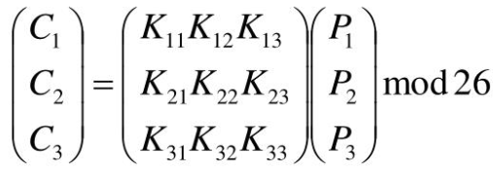
Hill Cipher
Encryption:
C = E(K, P) = KP mod 26.
Decryption
P = D(K^{-1 ,} C) = K⁻¹ C mod 26.

Slide 59
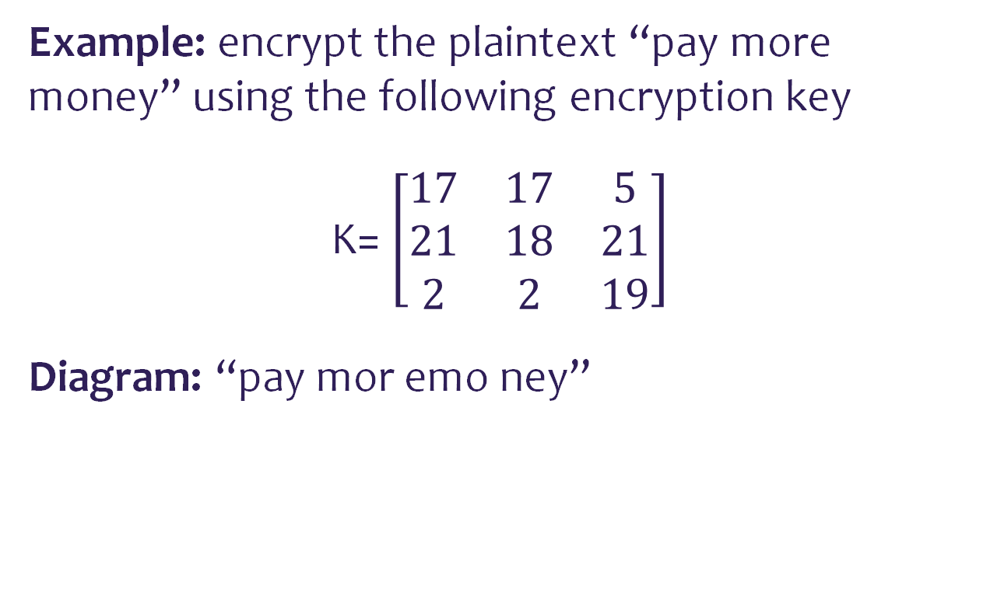
Hill Cipher Encryption
Example: encrypt the plaintext “pay more money” using the following encryption key
K= $\left[\begin{matrix}17 & 17 & 5 \\ 21 & 18 & 21 \\ 2 & 2 & 19\end{matrix}\right]$
Diagram: “pay mor emo ney”
p | a | y | m | o | r | e | m | o | n | e | y
15 | 0 | 24 | 12 | 14 | 17 | 4 | 12 | 14 | 13 | 4 | 24

Slide 60
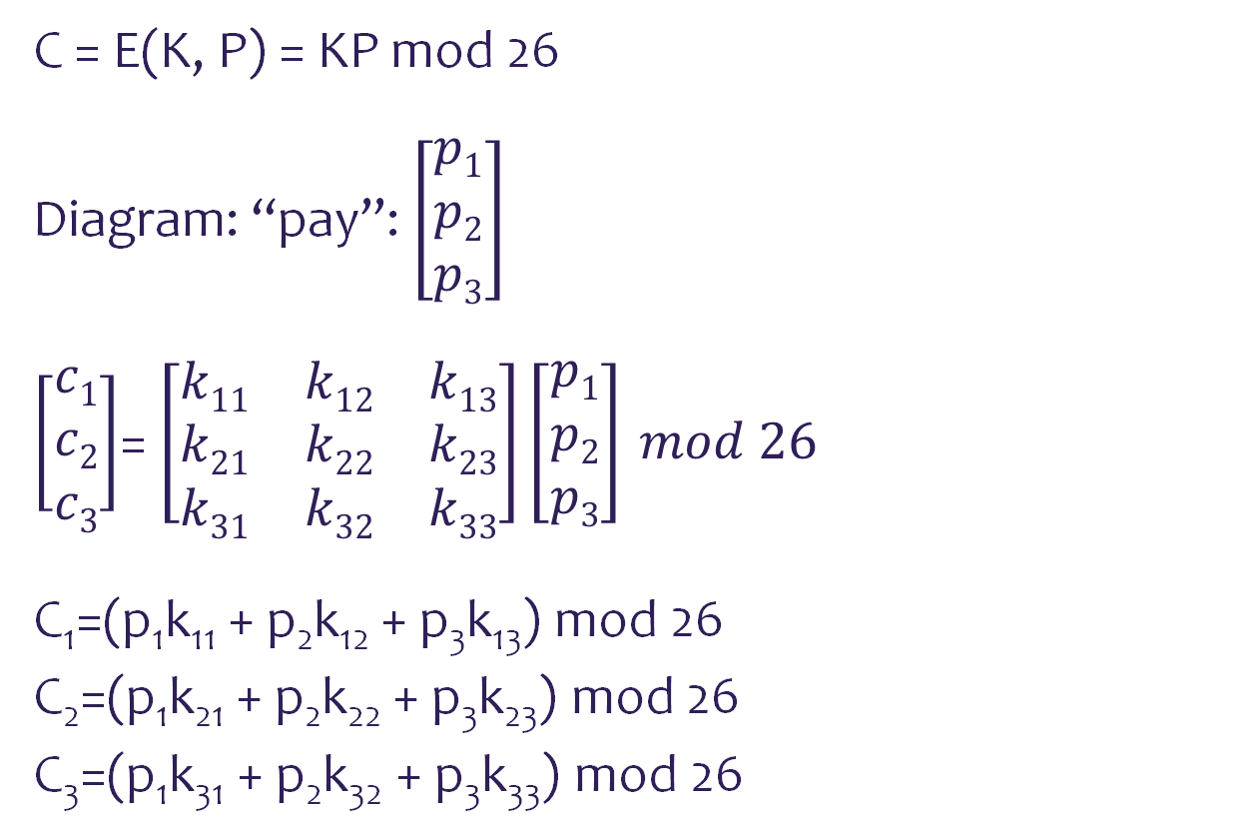
Hill Cipher Encryption
C = E(K, P) = KP mod 26
Diagram: “pay”: $\left[\begin{matrix}p1 \\ p2 \\ p3\end{matrix}\right]$
$\left[\begin{matrix}c1 \\ c2 \\ c3\end{matrix}\right]$= $\left[\begin{matrix}k11 & k12 & k13 \\ k21 & k22 & k23 \\ k31 & k32 & k33\end{matrix}\right]\left[\begin{matrix}p1 \\ p2 \\ p3\end{matrix}\right] mod 26$
C₁=(p₁k₁₁ + p₂k₁₂ + p₃k₁₃) mod 26
C₂=(p₁k₂₁ + p₂k₂₂ + p₃k₂₃) mod 26
C₃=(p₁k₃₁ + p₂k₃₂ + p₃k₃₃) mod 26

Slide 61
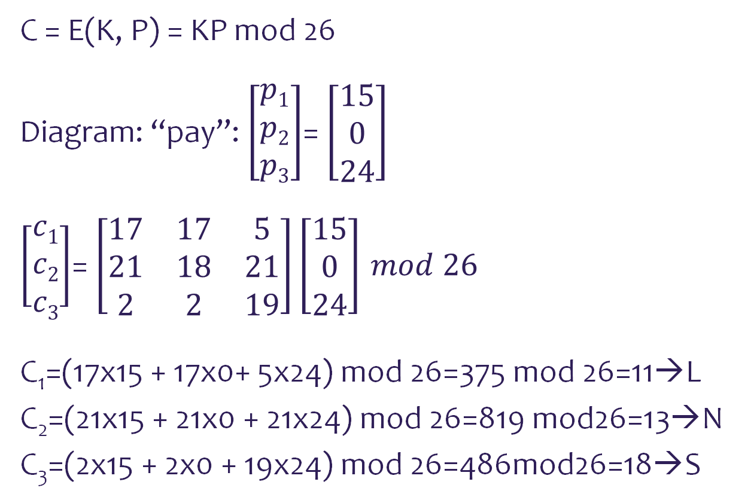
Hill Cipher Encryption
C = E(K, P) = KP mod 26
Diagram: “pay”: $\left[\begin{matrix}p1 \\ p2 \\ p3\end{matrix}\right]$= $\left[\begin{matrix}15 \\ 0 \\ 24\end{matrix}\right]$
$\left[\begin{matrix}c1 \\ c2 \\ c3\end{matrix}\right]$= $\left[\begin{matrix}17 & 17 & 5 \\ 21 & 18 & 21 \\ 2 & 2 & 19\end{matrix}\right]\left[\begin{matrix}15 \\ 0 \\ 24\end{matrix}\right] mod 26$
C₁=(17x15 + 17x0+ 5x24) mod 26=375 mod 26=11→L
C₂=(21x15 + 21x0 + 21x24) mod 26=819 mod26=13→N
C₃=(2x15 + 2x0 + 19x24) mod 26=486mod26=18→S

Slide 62
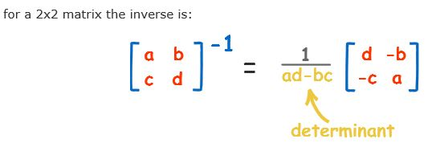
Hill Cipher Decryption
To decrypt ciphertext coded by hill cipher with matrix K, we need K⁻¹ (Inverse of Key matrix).

Slide 63
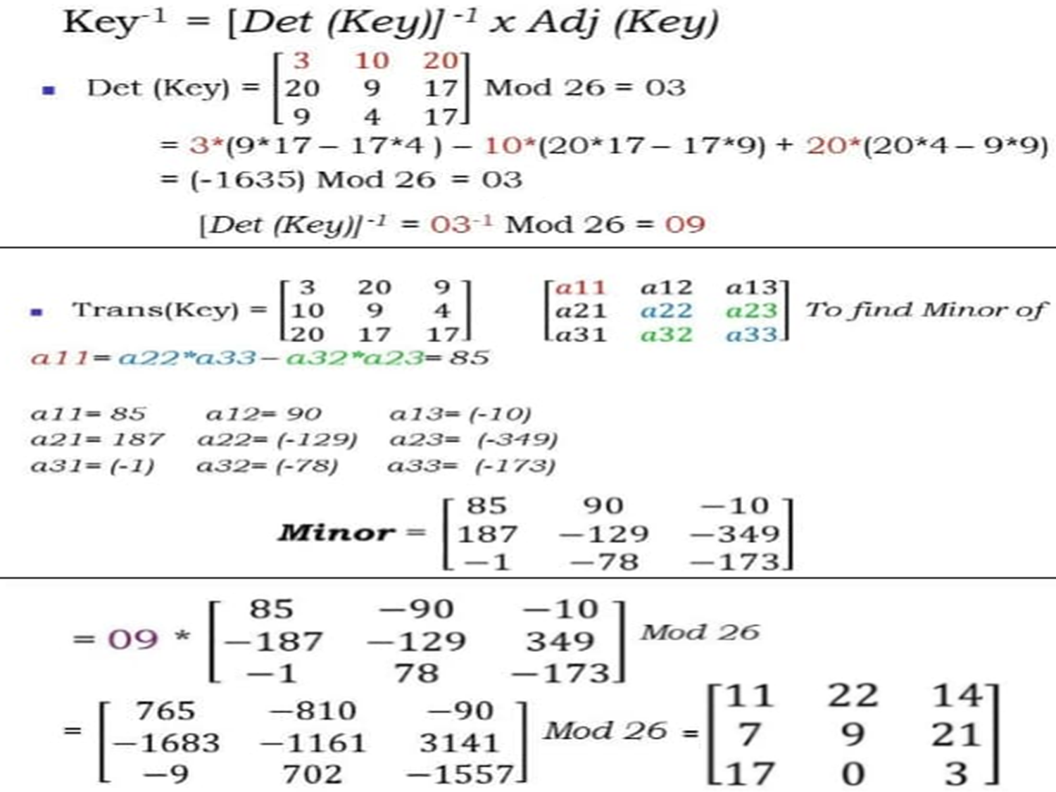

Slide 64
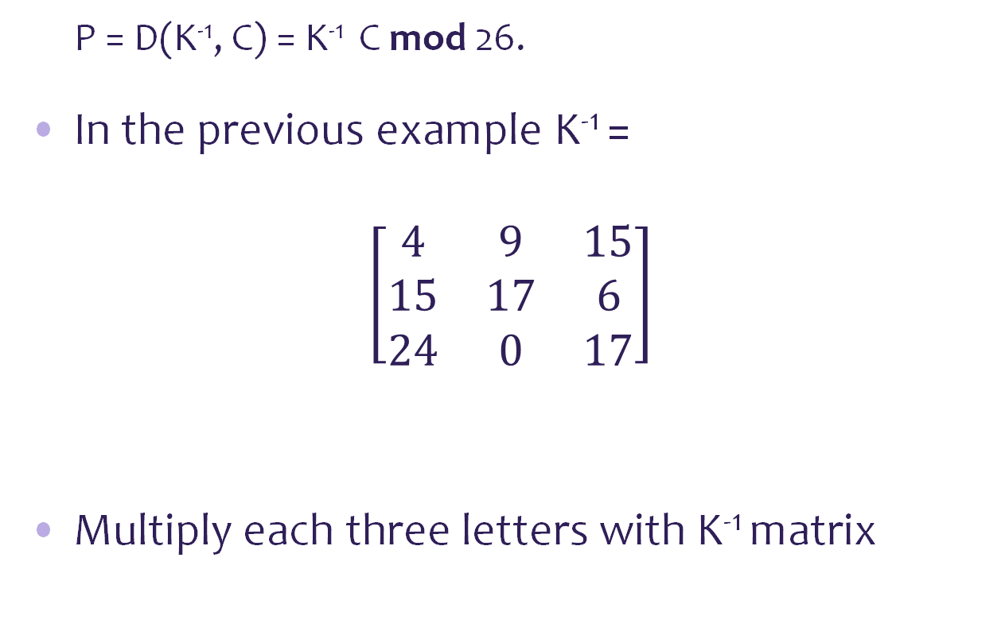
Hill Cipher Decryption
P = D(K⁻¹, C) = K⁻¹ C mod 26.
In the previous example K⁻¹ =
$$\left[\begin{matrix}4 & 9 & 15 \\ 15 & 17 & 6 \\ 24 & 0 & 17\end{matrix}\right]$$
Multiply each three letters with K⁻¹ matrix

Slide 65
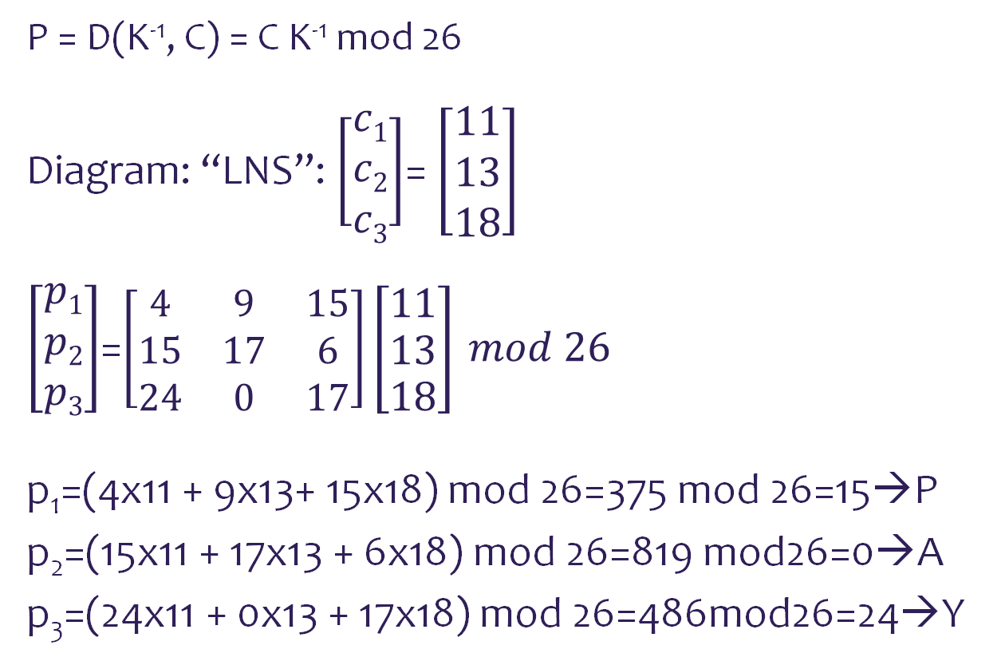
Hill Cipher Encryption
P = D(K⁻¹, C) = C K⁻¹ mod 26
Diagram: “LNS”: $\left[\begin{matrix}c1 \\ c2 \\ c3\end{matrix}\right]$= $\left[\begin{matrix}11 \\ 13 \\ 18\end{matrix}\right]$
$\left[\begin{matrix}p1 \\ p2 \\ p3\end{matrix}\right]$=$\left[\begin{matrix}4 & 9 & 15 \\ 15 & 17 & 6 \\ 24 & 0 & 17\end{matrix}\right]\left[\begin{matrix}11 \\ 13 \\ 18\end{matrix}\right] mod 26$
p₁=(4x11 + 9x13+ 15x18) mod 26=375 mod 26=15→P
p₂=(15x11 + 17x13 + 6x18) mod 26=819 mod26=0→A
p₃=(24x11 + 0x13 + 17x18) mod 26=486mod26=24→Y

Slide 66
Hill Cryptanalysis
Hill Cipher Strong against a ciphertext-only attack but easily broken with a known plaintext attack.
For an m * m Hill Cipher, suppose we have m (P,C) pairs each of same length.
As cryptanalyst your target is to recover K matrix.
If we get the plaintext and its correspondent cipher text, then we can recover K matrix.
K = C * P⁻¹

Slide 67
Hill Cryptanalysis
Example : Suppose P = “Friday” is encrypted using 2 x 2 Hill Cipher to yield C = “PQCFKU”.
P: F = 5 ; I = 8 ; A = 0
R 17 D 3 Y 24
----------------------------------------------------------------------------------
C: P = 15 ; C = 2 ; K = 10
Q 16 F 5 U 20
Using the first two P-C pairs

Slide 68
Hill Cryptanalysis
K = C * P⁻¹
C= 15 2 P= 5 8
16 5 17 3
-------------------------------------------------------------------------
P⁻¹ = 5 8 9 2
17 3 1 15
-1
=

Slide 69
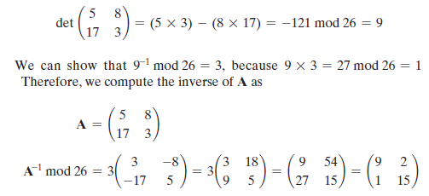
Hill Cryptanalysis

Slide 70
Hill Cryptanalysis
(C * P ⁻¹ ) mod 26 = K
15 2 9 2 137 60
16 5 1 15 149 107
-------------------------------------------------------------------------
K 7 8
19 3
*
mod 26
=
=

Slide 71
Transposition

Slide 72
Rail Fence Cipher
Simplest transposition cipher
Plaintext is written down as a sequence of diagonals and then read off as a sequence of rows
To encipher the message “meet me at one pm” with a rail fence of depth 2, we would write:
Encrypted message is: memaoemetetnp
 | o |  | a |  | m |  | e |  | m
n |  | t |  | e |  | t |  | e
Notes:
All the techniques examined so far involve the substitution of a ciphertext symbol
for a plaintext symbol. A very different kind of mapping is achieved by performing
some sort of permutation on the plaintext letters. This technique is referred to as a
transposition cipher.
The simplest such cipher is the rail fence technique, in which the plaintext is
written down as a sequence of diagonals and then read off as a sequence of rows.
For example, to encipher the message “meet me after the toga party” with a rail
fence of depth 2, we write the following:
m e m a t r h t g p r y
e t e f e t e o a a t
The encrypted message is
MEMATRHTGPRYETEFETEOAAT

Slide 73
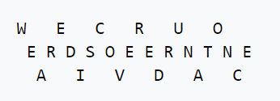
Rail Fence Cipher
To encipher the message “we are discovered run at once” with a rail fence of depth 3, we would write:
“WECRUOERDSOEERNTNEAIVDAC”
Since the ciphertext is the same as the plaintext, the number of usable keys is low, allowing the brute-force attack of trying all possible keys. As a result, the rail-fence cipher is considered weak.

Slide 74
Row Transposition Cipher
Is a more complex transposition
Write the message in a rectangle, row by row, and read the message off, column by column, but permute the order of the columns
The order of the columns then becomes the key to the algorithm
Notes:
A more complex scheme is
to write the message in a rectangle, row by row, and read the message off, column
by column, but permute the order of the columns. The order of the columns then
becomes the key to the algorithm. For example,
Key: 4 3 1 2 5 6 7
Plaintext: a t t a c k p
o s t p o n e
d u n t i l t
w o a m x y z
Ciphertext: TTNAAPTMTSUOAODWCOIXKNLYPETZ
Thus, in this example, the key is 4312567. To encrypt, start with the column
that is labeled 1, in this case column 3. Write down all the letters in that column.
Proceed to column 4, which is labeled 2, then column 2, then column 1, then
columns 5, 6, and 7.
A pure transposition cipher is easily recognized because it has the same letter
frequencies as the original plaintext. For the type of columnar transposition just
shown, cryptanalysis is fairly straightforward and involves laying out the ciphertext
in a matrix and playing around with column positions. Digram and trigram
frequency tables can be useful.
The transposition cipher can be made significantly more secure by performing
more than one stage of transposition. The result is a more complex permutation
that is not easily reconstructed.

Slide 75
Row Transposition Cipher
Example :
Plaintext: attack postponed until two am
Key: 4 3 1 2 5 6 7
Plaintext: a t t a c k p
o s t p o n e
d u n t i l t
w o a m x y z
Ciphertext: TTNAAPTMTSUOAODWCOIXKNLYPETZ
Notes:
Decryption accord to the key ,,,
28/7 = 4 rows
T T N A A P T M T S U O A O D W C O I X K N L Y P E T Z
1 2 3 4 5 6 7
T A T A C K P
T P S O O L E
N T U D I N T
A M O W X Y Z

Slide 76
Thank you
☺

